Slide 1
Modelling decision-making with dynamical systems

Slide 2
Summary
What we do
Briefly discuss pros and cons of using dynamical systems to model decision-making
Investigate a general but unrealistic model of decision-making
How bifurcatins

Slide 3
What we do
Pros and cosn of dynamical systes for decision making
Analzing a model of decision making for one agent
Bifurcattions in decision making (some conepcts will be generalible to multiple opnions)
Separation of timescale and its application for flexible decision making
Multiagent decision making and ring attractor, symmetries, selective ultra sensitivity

Slide 4
What are dynamical systems

Slide 5
Why dynamical systems for decision making
Consensus (good)
Accuracy (bad)
Extra good for collective decision-making

Slide 6

Why not dynamical systems
Dynamical systems assume infinite population size
Macroscopical description
Mechanistic models: can be derived from microscopical description
Phenomenological models: cannot be derived by microscopic description
*This is one possible interpretation, different people can mean different things

Slide 7
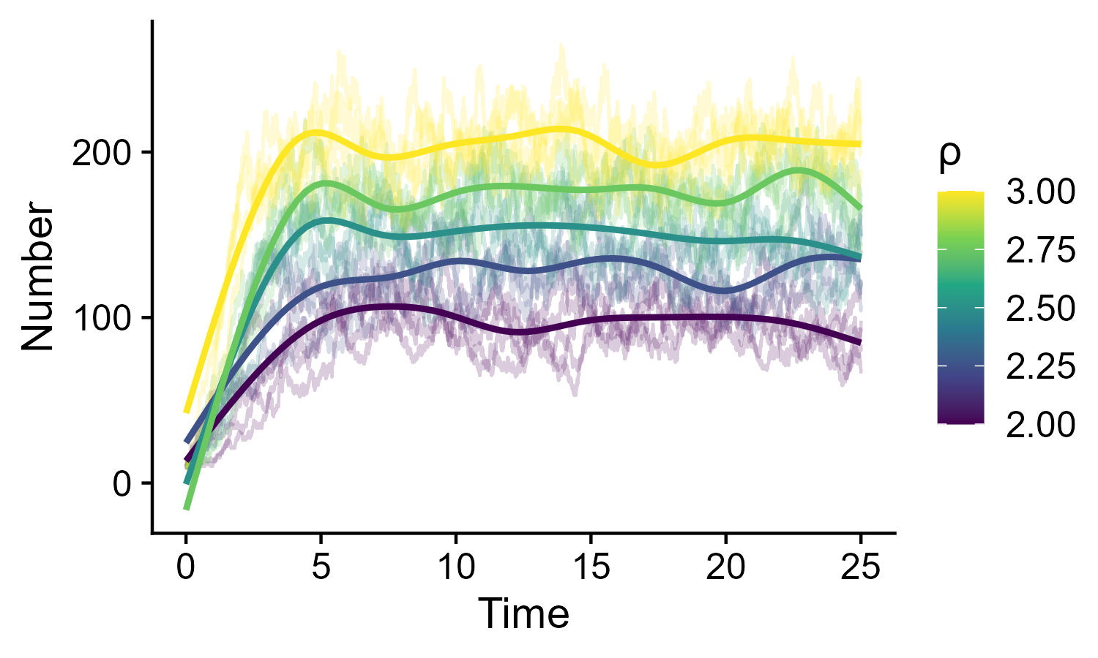

The problem with phenomenological models
Increasing ρ, will K:
Increase
Decrease
Stay the same
Macroscopic
Logistic growth equation
Clonal reproduction
Microscopic
Death
Density dependent death
Phenomenological models can lead to false conclusions

Slide 8
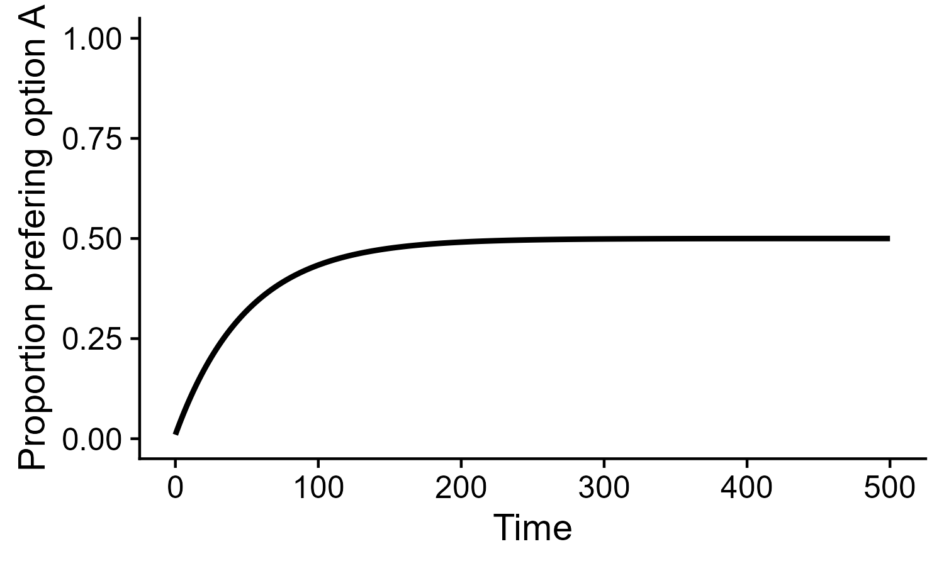
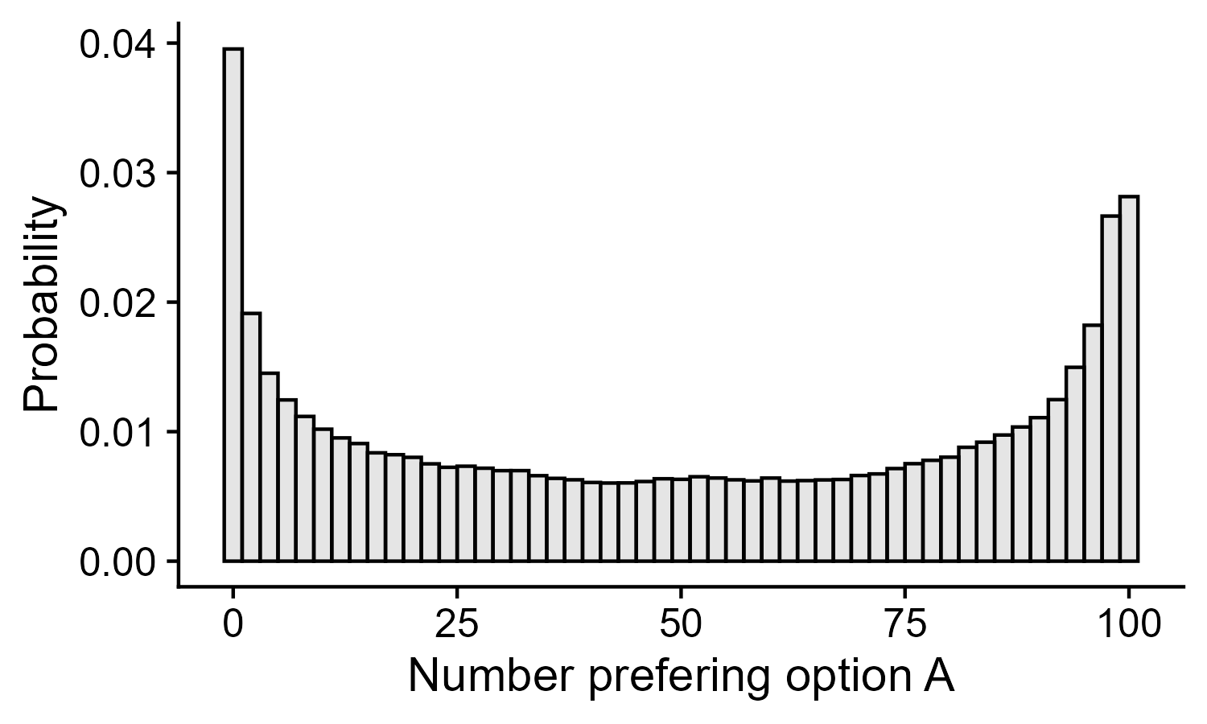
The problem with macroscopic models
Voter model
Voter model
What is the shape for the probability of a population state:
Flat
Approximately gaussian (centered at 0.5)
Bimodal
Macroscopic models can miss dynamical outcomes (noise induced effects)

Slide 9
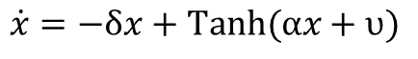
Non-linear opinion dynamics model (NOD)
One agent, two options
Can x explode to infinity:
No
Depends on parameter values
Yes
$$\dot{x}=−δx+Tanh⁡(αx+υ)$$
This is node of neural network
Neurons are complex (REF) and perform computations

Slide 10
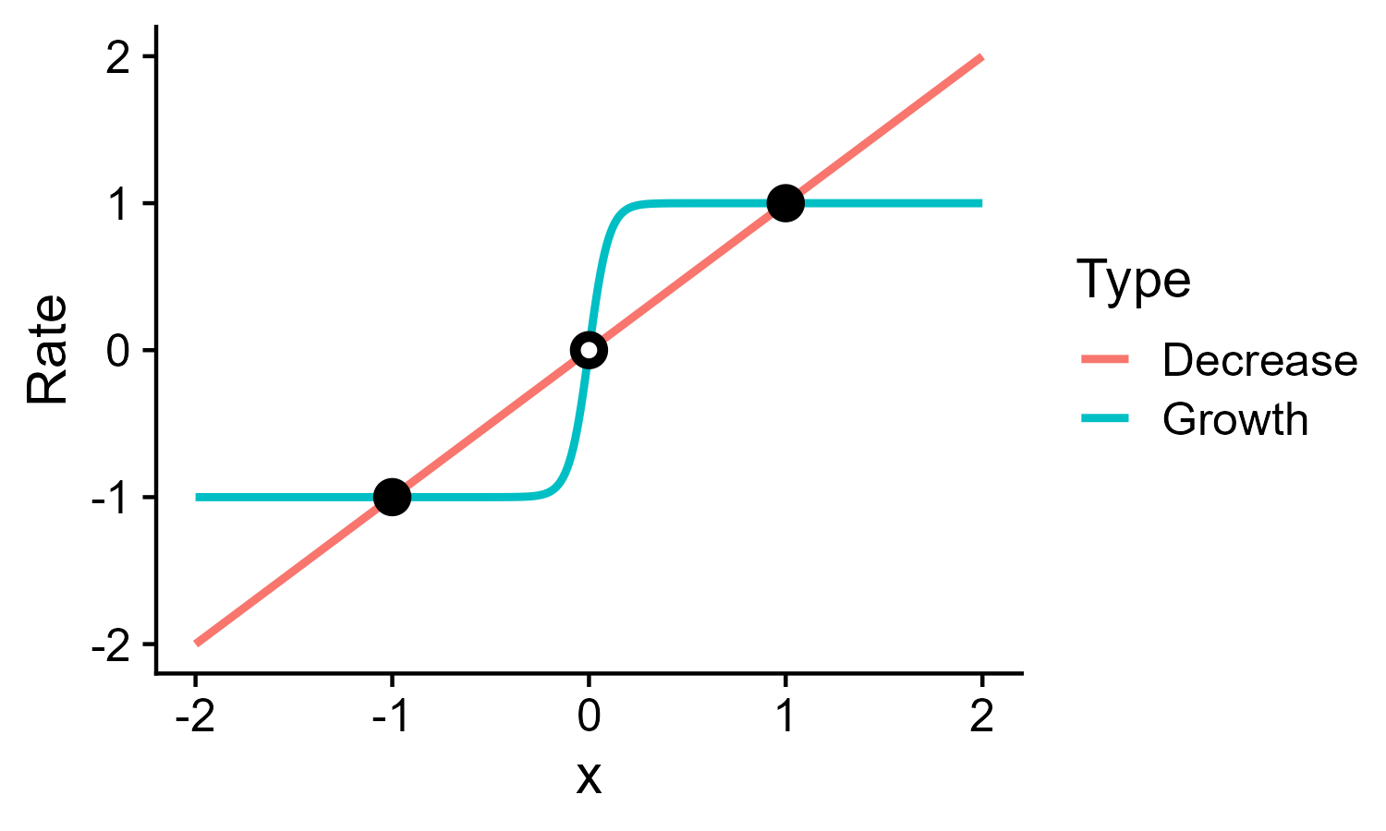
Non-linear opinion dynamics model (NOD)
One agent, two options
One agent, two options
Can x explode to infinity:
No
Depends on parameter values
Yes
Linear
Linear
$$\dot{x}=−δx+Tanh⁡(αx+υ)$$
$$\dot{x}=−δx+Tanh⁡(αx+υ)$$
Constant for high x (tanh is monotonic and has bunded domain)
Linear term wins on constant term
This is node of neural network
Neurons are complex (REF) and perform computations

Slide 11
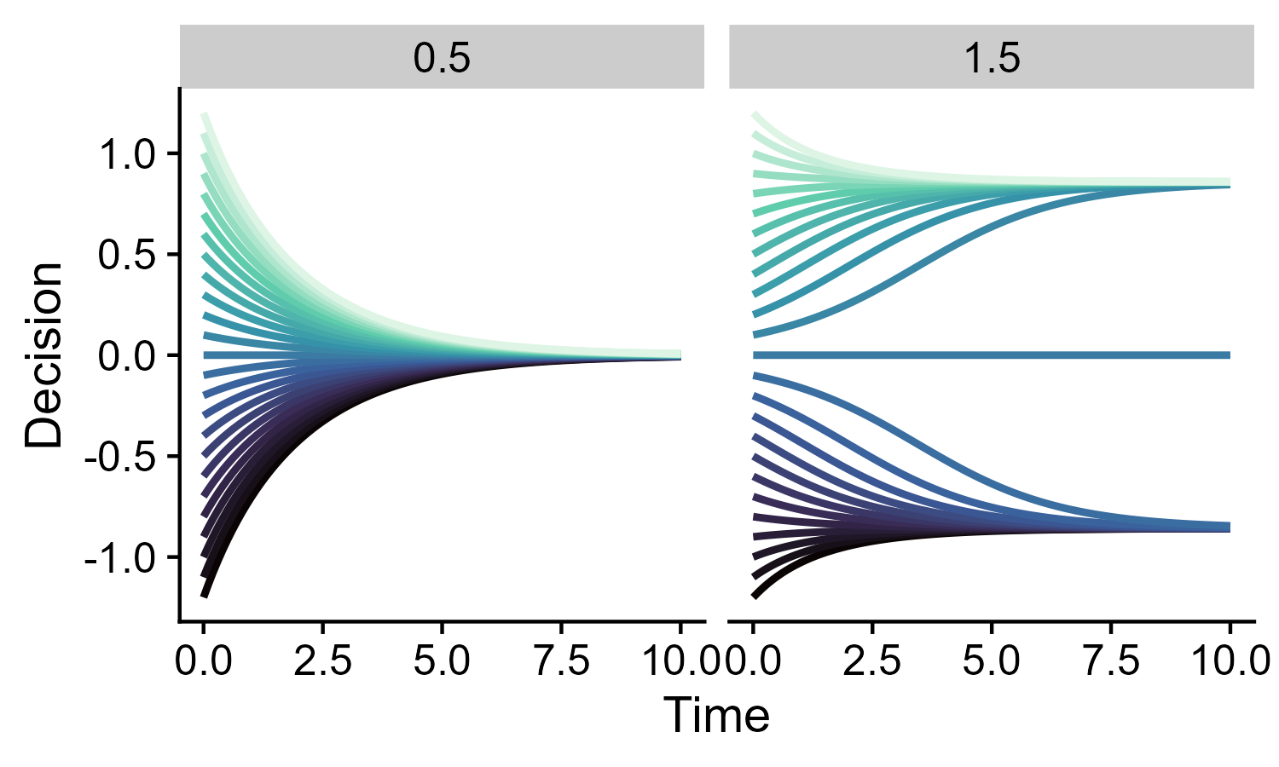
Qualitative vs Quantitative analysis
Qualitative more interpretable and robust
Time series visualization (connect to bifurcation diagrams)

Slide 12
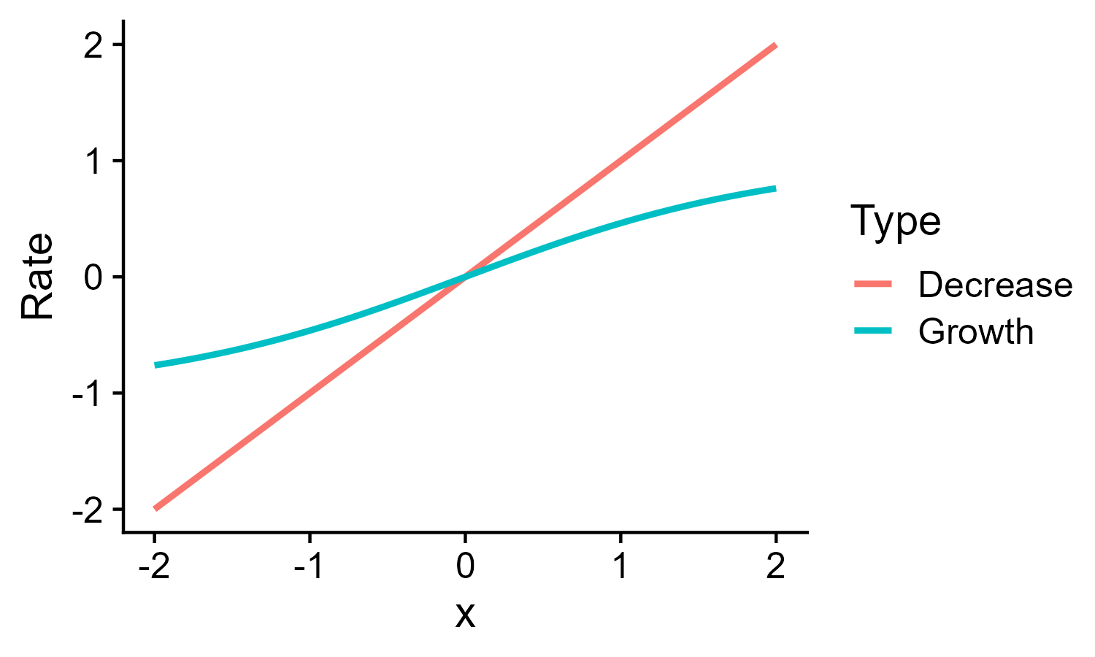
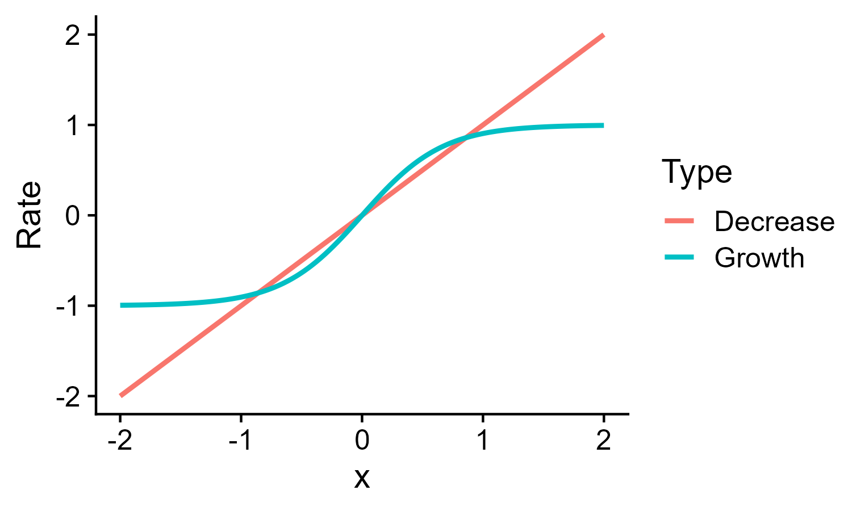
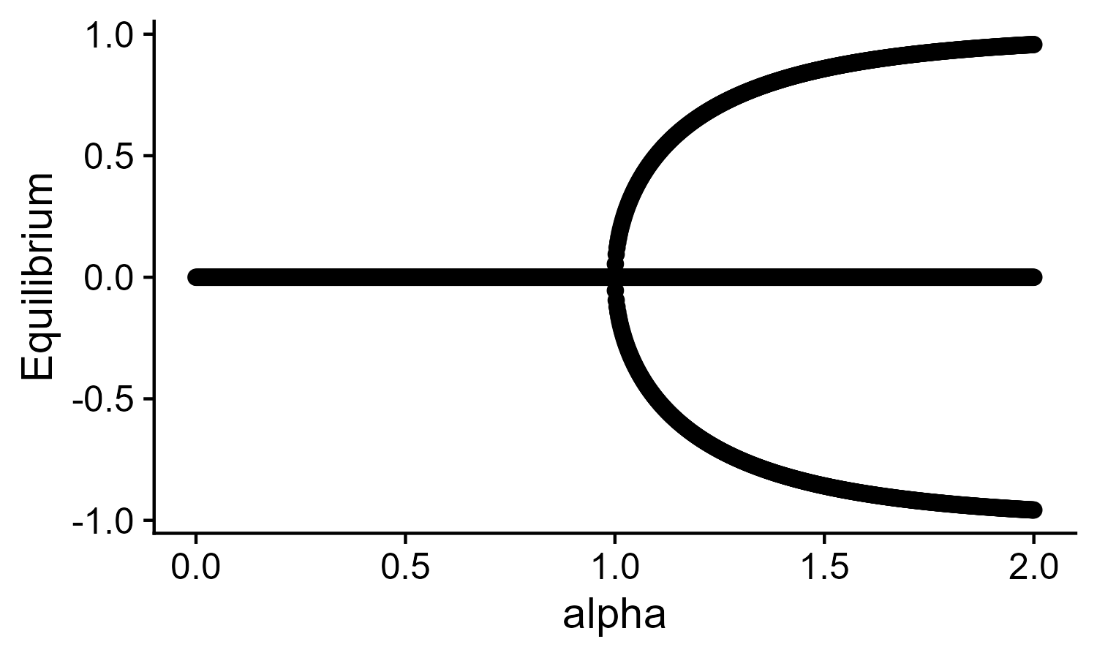
Bifurcation diagrams
Implicit function theorem
Numerical continuation techinques
Bifurcations
What is the shape of the Jacobian:
a)

Slide 13
Elementary bifurcations
Regular form
Saddle node
Transcritical
Pitchfork
Hopf(not show but cite)
Universal unfolding theorem (from pitchfork to other) (show diagram)
Applicable also for high dimensional dynamical systems (Lyapunov-Smhidt central manifold model reductions)
What are the possible shapes of a bifurcation diagrams?

Slide 14
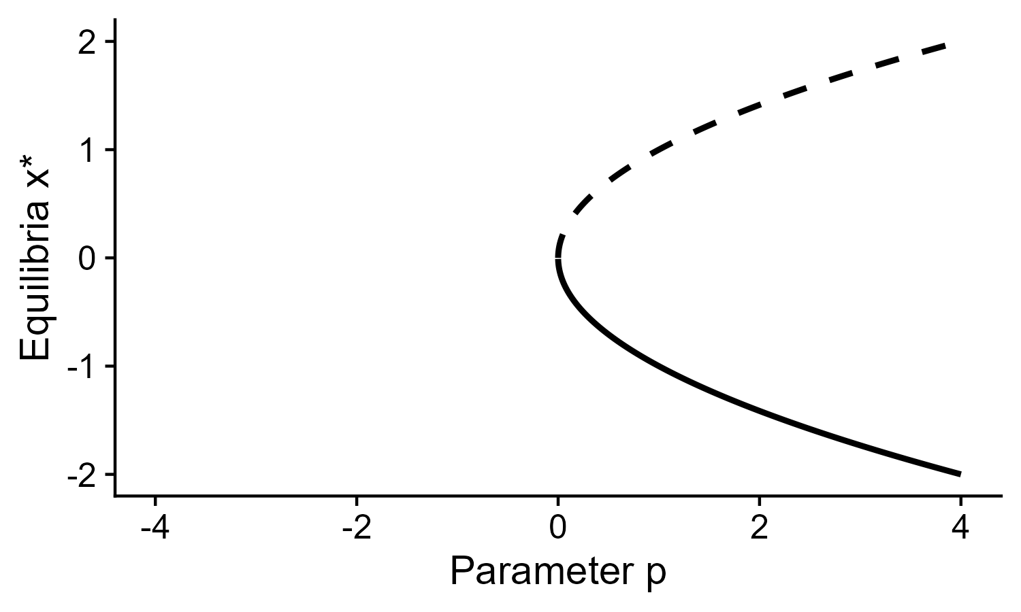
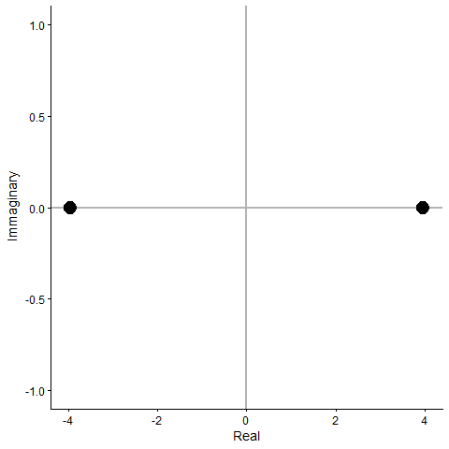
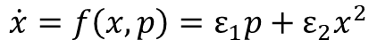
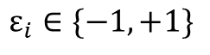
Saddle node bifurcation
Normal form
$$\dot{x}=f\left(x, p\right)=ε_{1}p+{ε_{2}x}^{2}$$
Eigenvalues of Jacobian
$$ε_{i}∈\{−1,+1\}$$

Slide 15

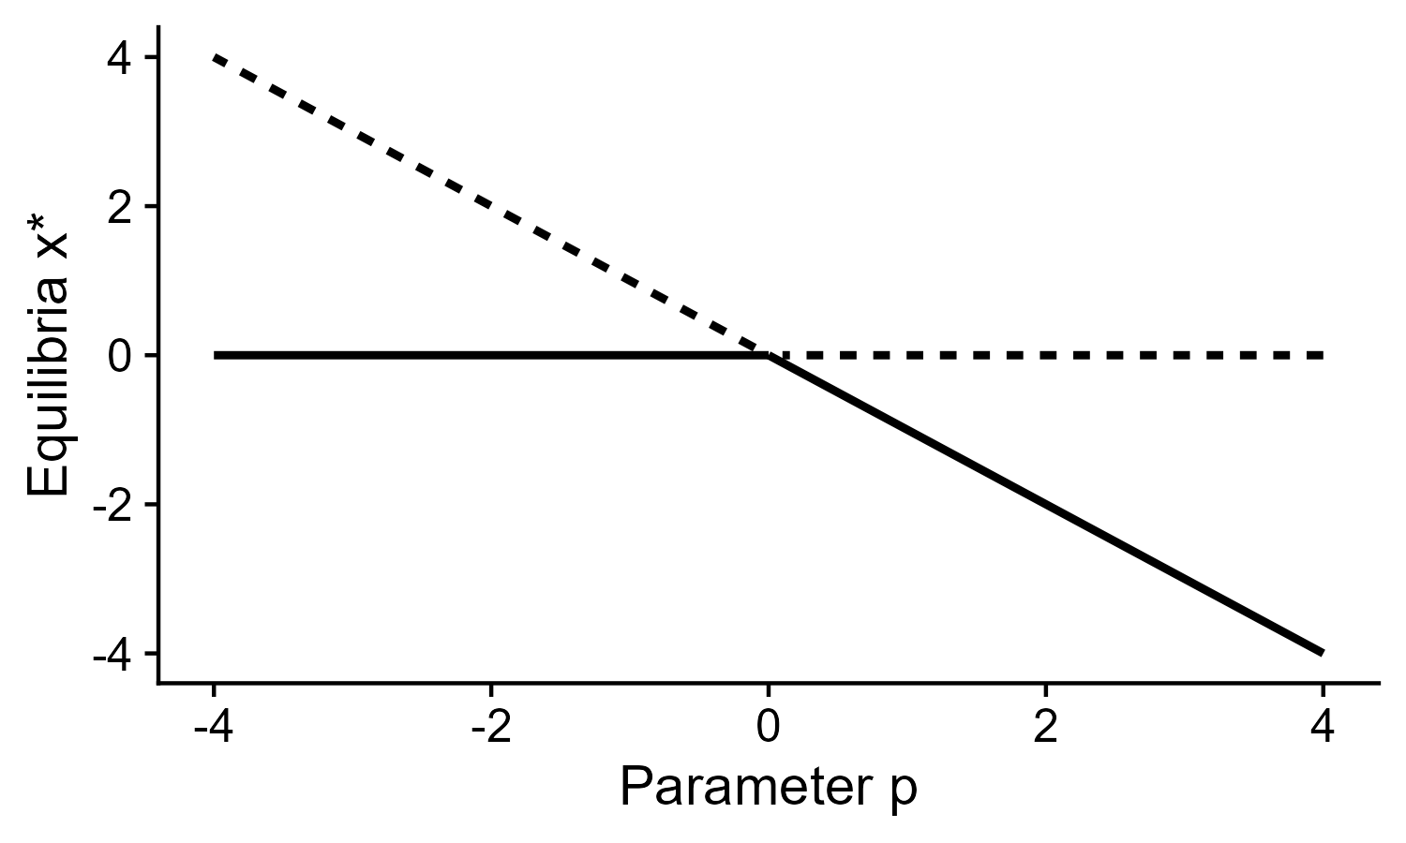
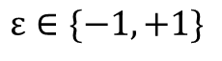
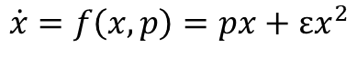
Transcritical bifurcation
Normal form
$$\dot{x}=f\left(x, p\right)=px+{εx}^{2}$$
$$ε∈\{−1,+1\}$$
Eigenvalues of Jacobian

Slide 16
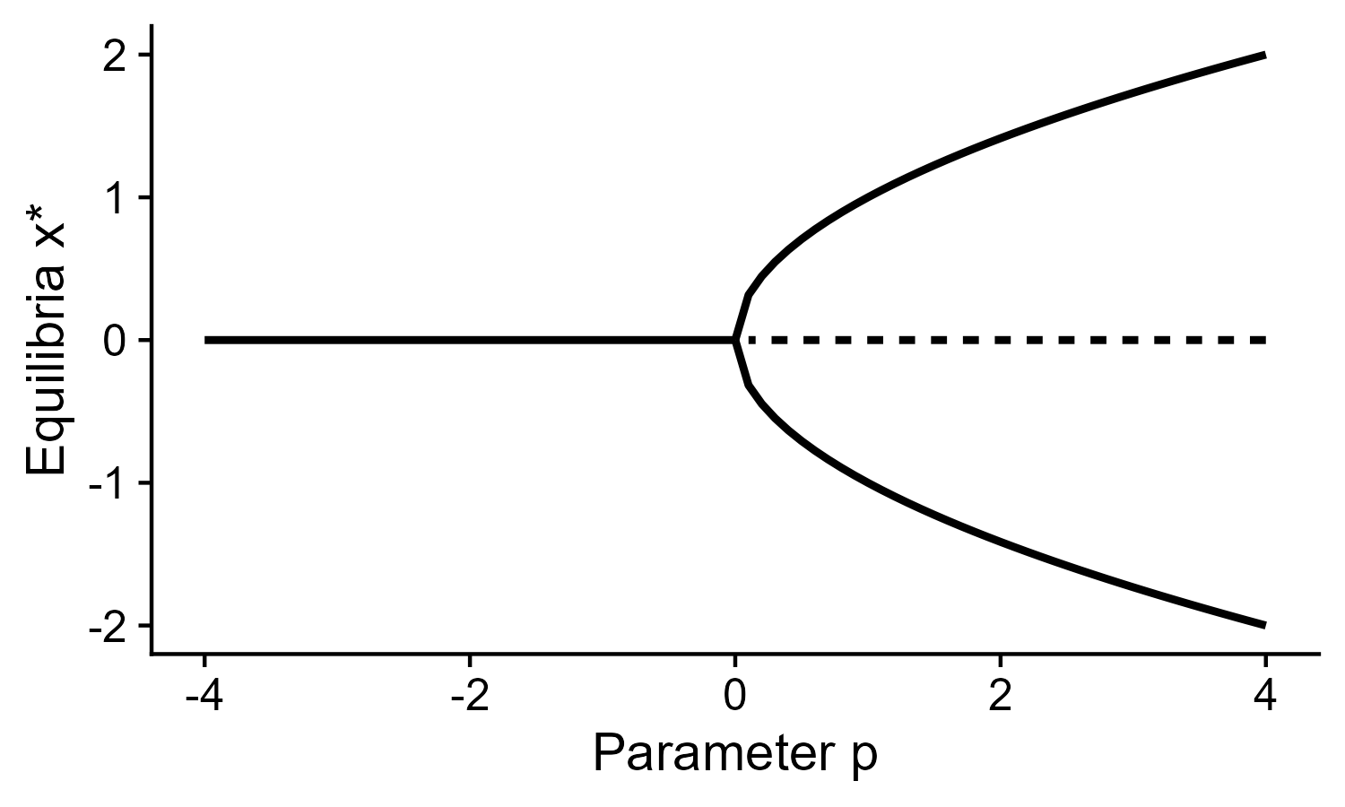
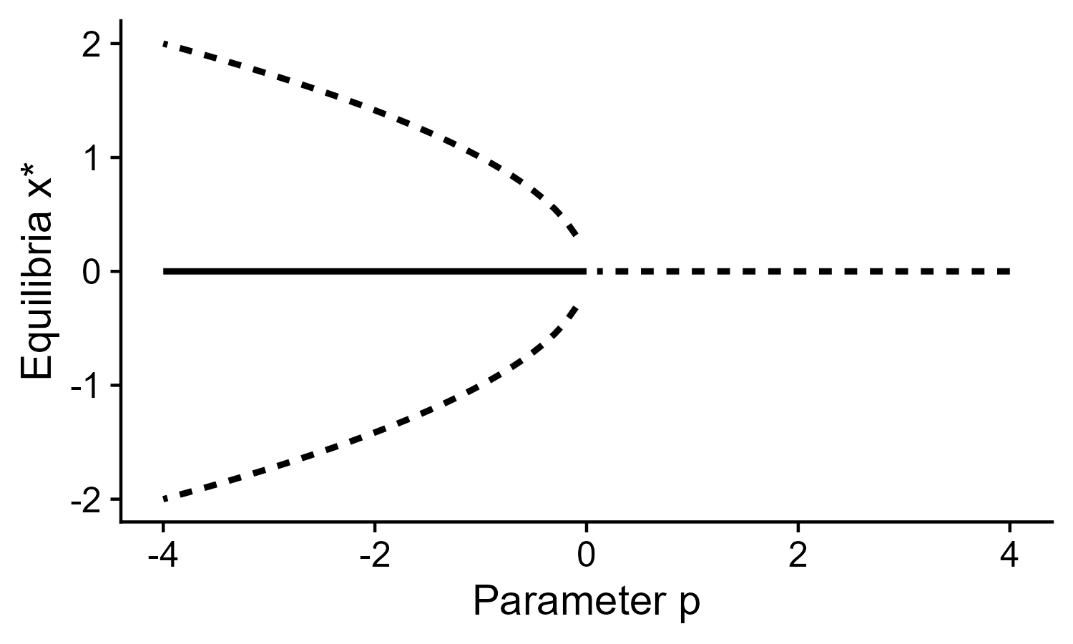
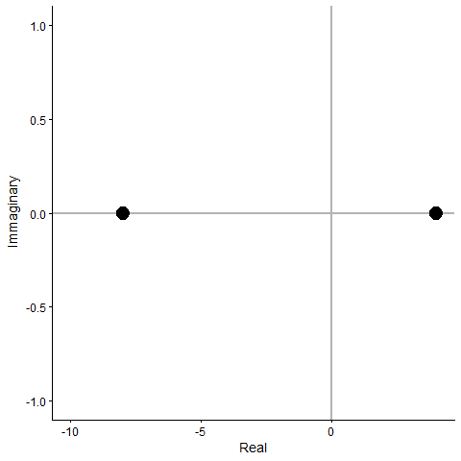
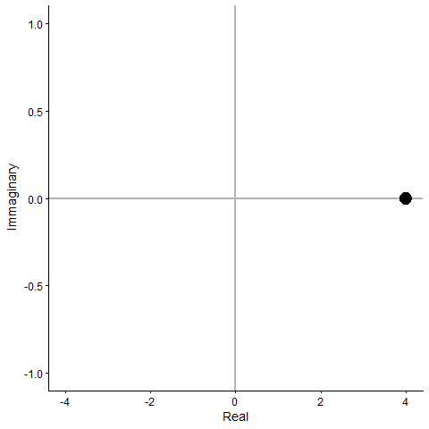
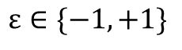
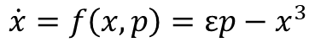
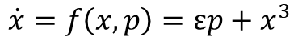

Pitchfork bifurcation
Normal form (supercritical)
Normal form (subcritical)
$$\dot{x}=f\left(x, p\right)=εp−x^{3}$$
$$\dot{x}=f\left(x, p\right)=εp+x^{3}$$
$$ε∈\{−1,+1\}$$
$$ε∈\{−1,+1\}$$
Which bifurcation does $\dot{x}=−δx+\operatorname{Tanh}\left(αx+υ\right)$ have?

Slide 17
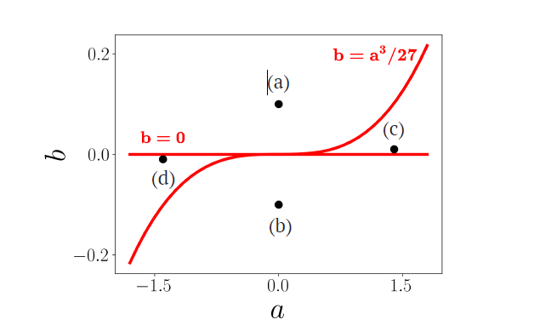
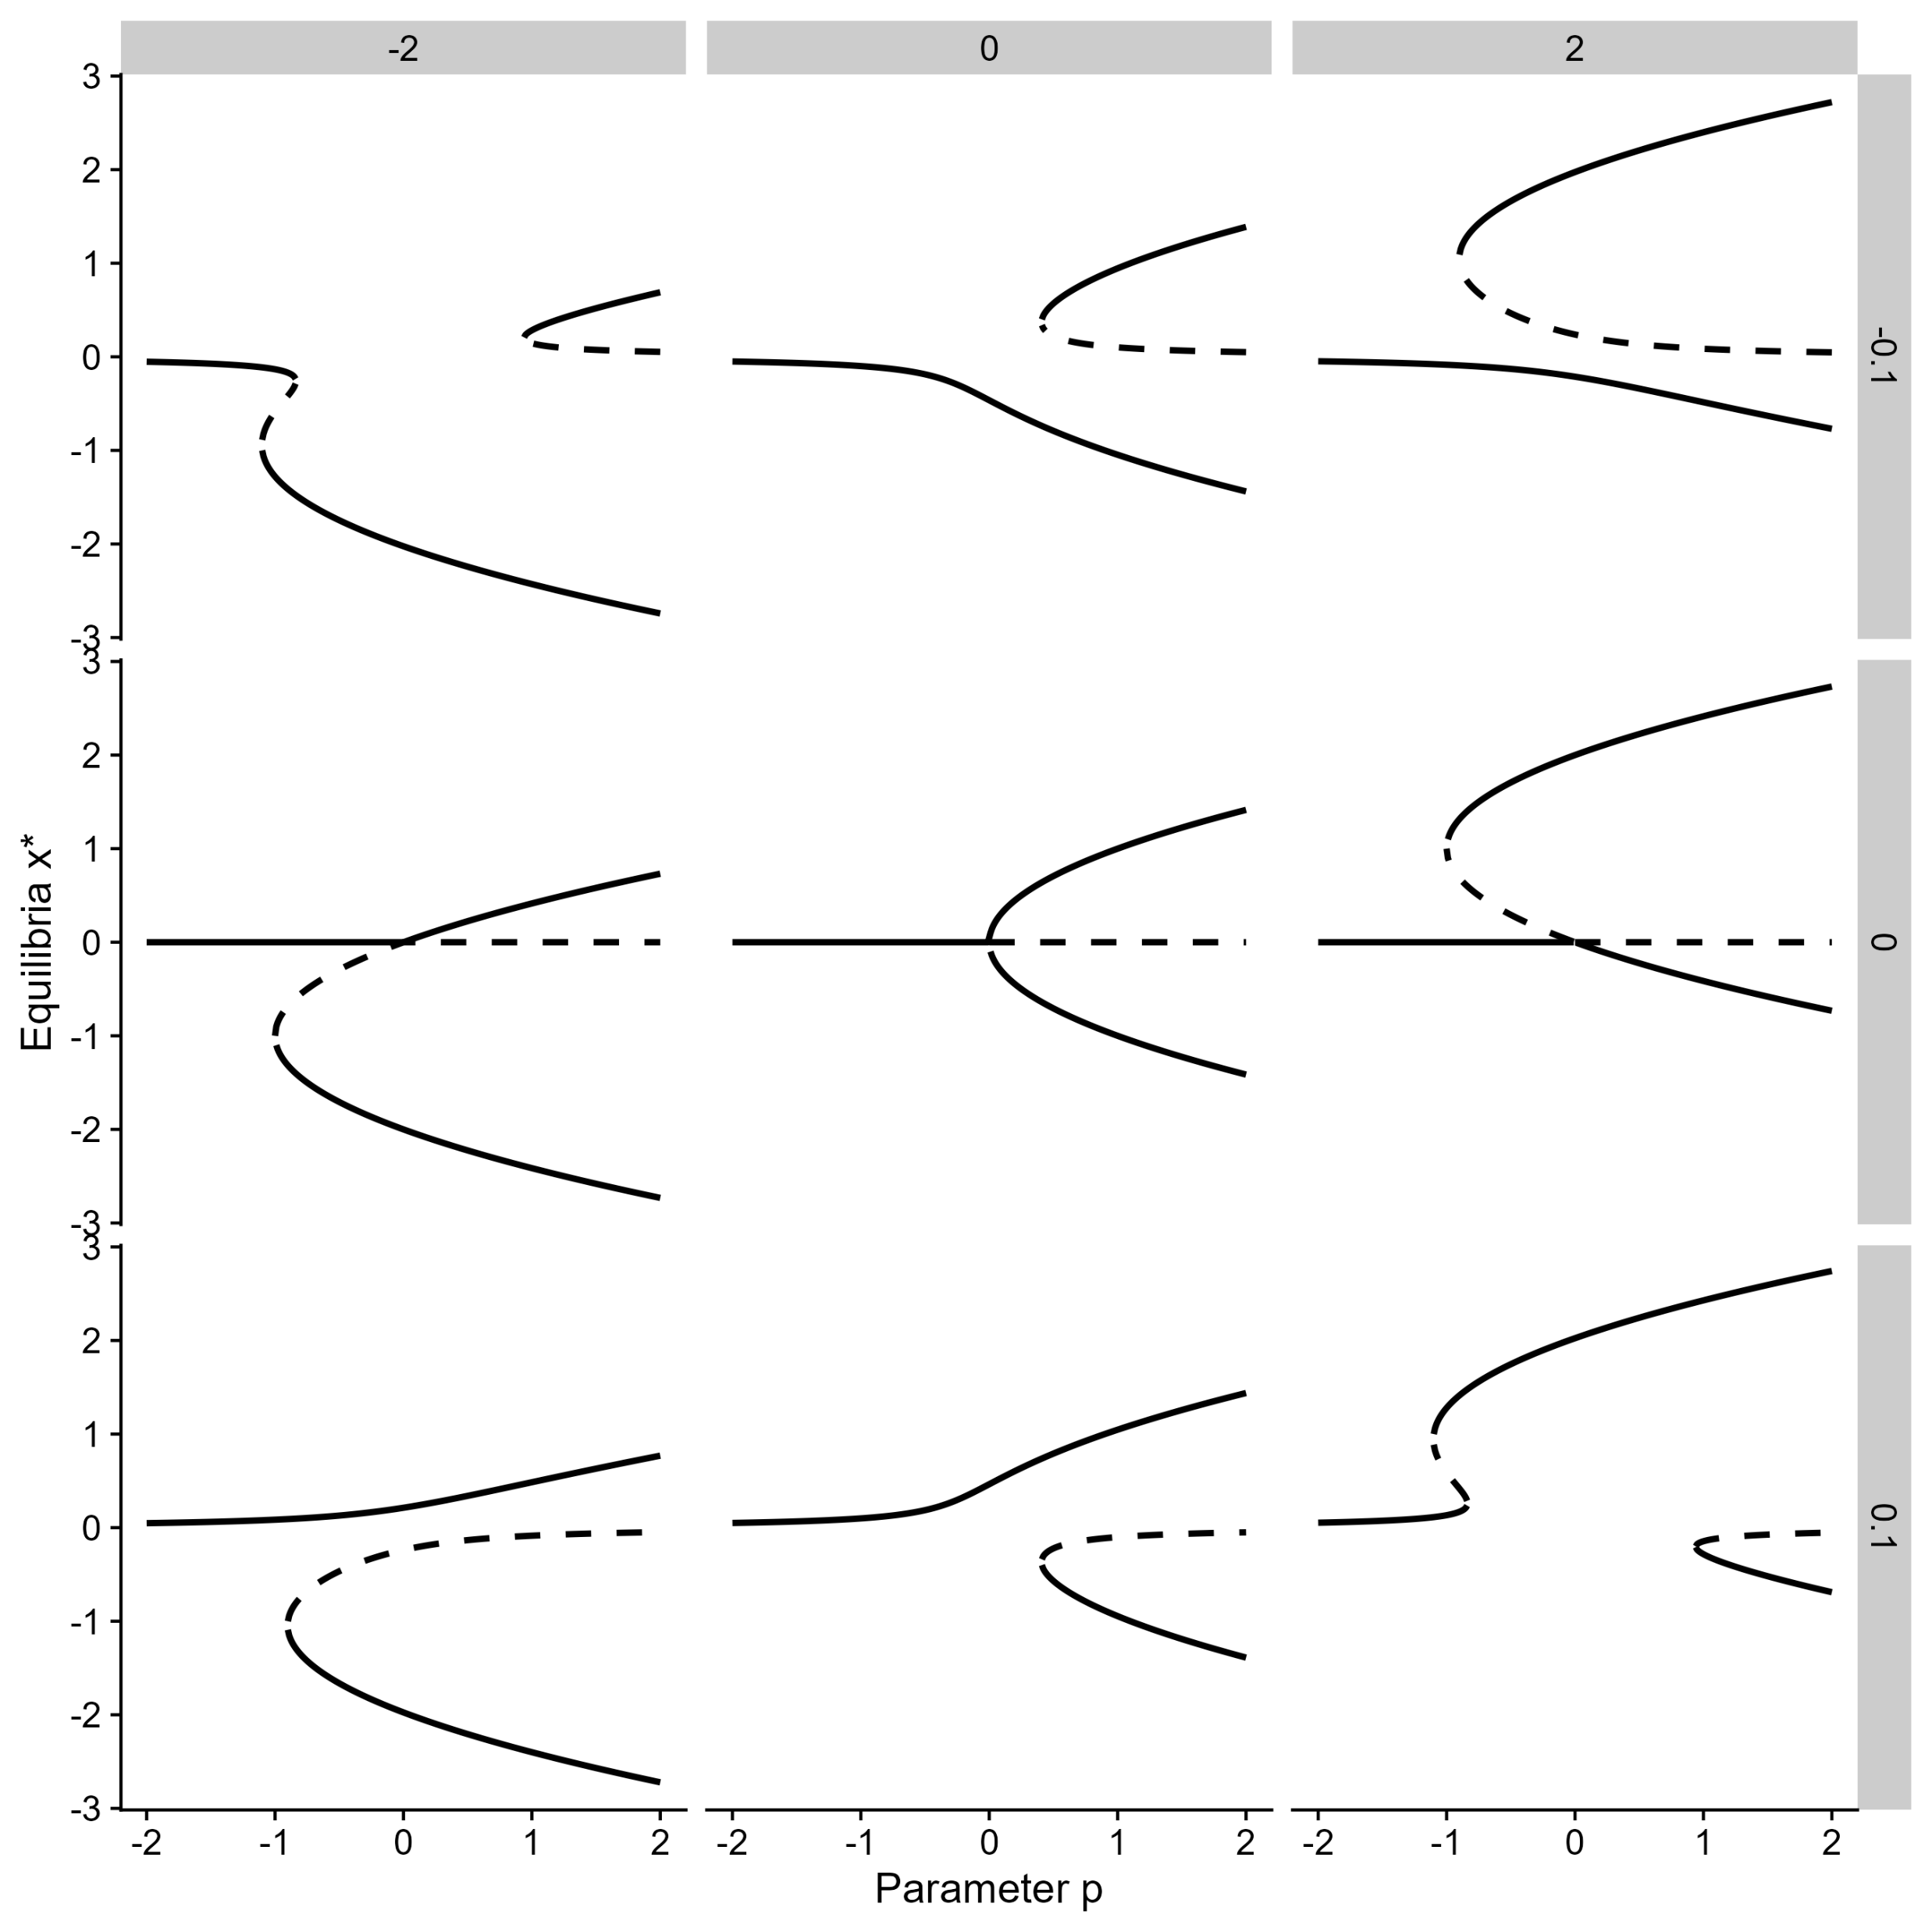
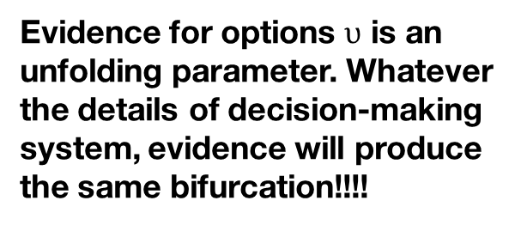
Universal unfolding theorem
There are a finite number of ways the bifurcation of $\dot{x}=f\left(x,p,r=0\right)$ transforms into the bifurcation of $\dot{x}=g\left(x,p,r≠0\right).$ r are the unfolding parameters, $r≠0$ correspond to a parametric perturbation
Universal unfolding of pitchfork
$$\dot{x}=g\left(x, p,a,b\right)=−x^{3}+ax^{2}+px+b$$
Evidence for options $υ$ is an unfolding parameter. Whatever the details of decision-making system, evidence will produce the same bifurcation!!!!
Bifurcation theory tells the number of parameters that describe the unfolding of a bifurcation. For the pitchfork, $r∈ℝ^{n},n=2$.

Slide 18
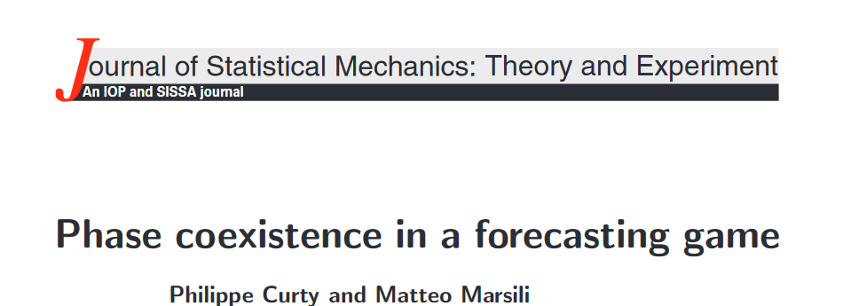
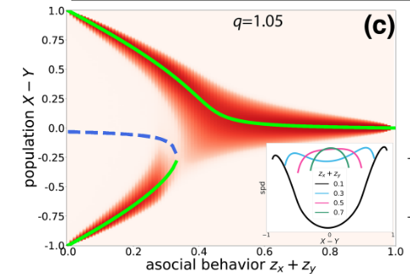
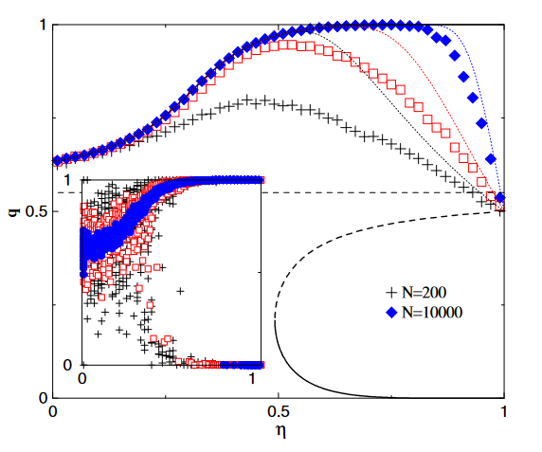
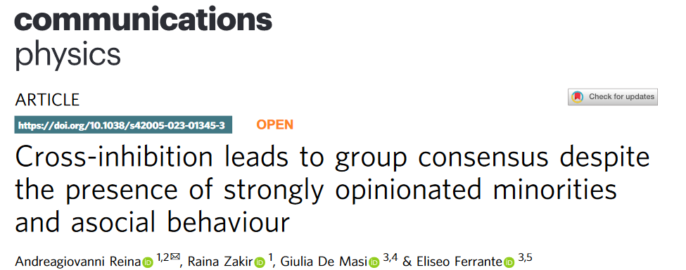
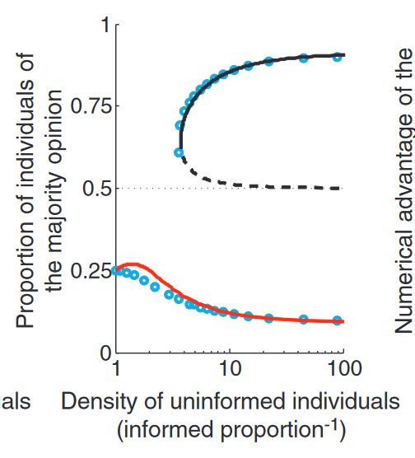
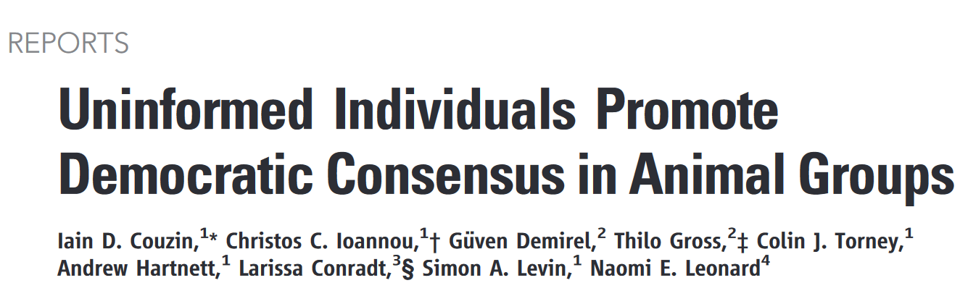
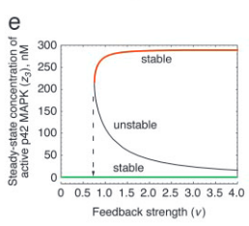


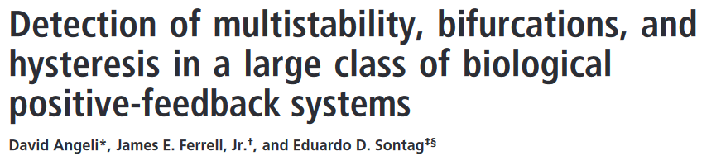
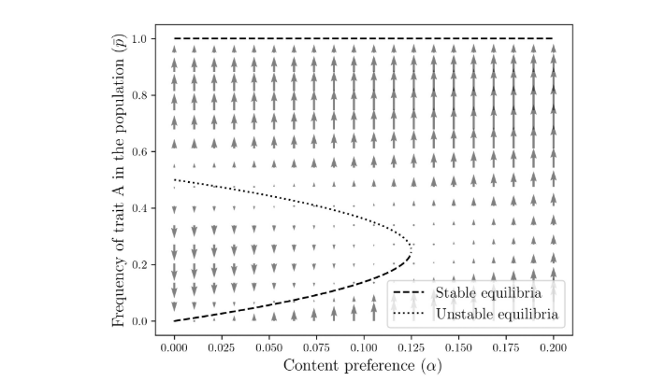
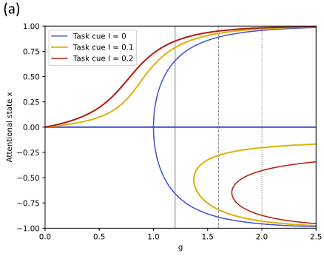
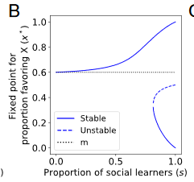


Slide 19
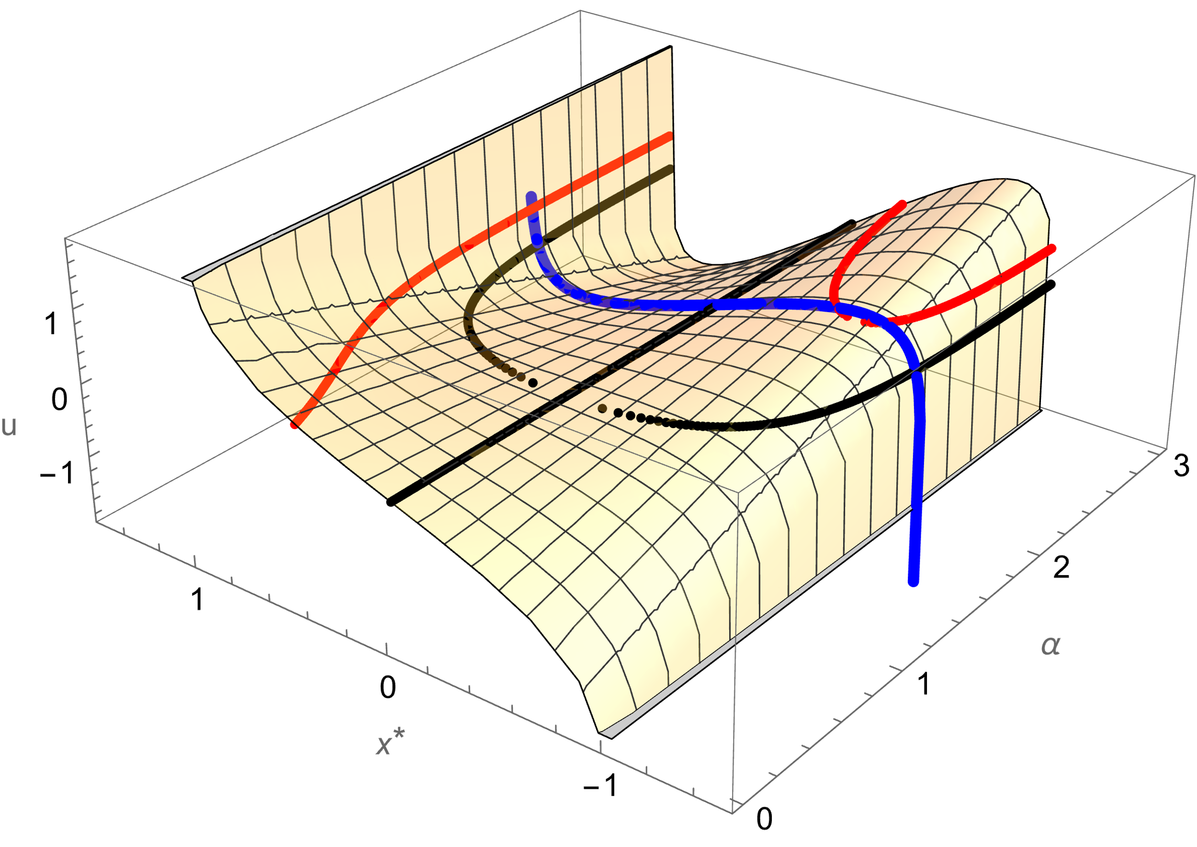

Slide 20

Histeresis
Catastrophe plot
Memory and path dependency
Impact for flexibility
Show three-dimensional plot
Problem of dynamical systems: inputs are parameters
How will NOD unfold for $υ>1$:(show jacobian)

Slide 21
Ultra-sensitivity
Compare supercritical to subcritical
Role of thresholds for decision-making

Slide 22
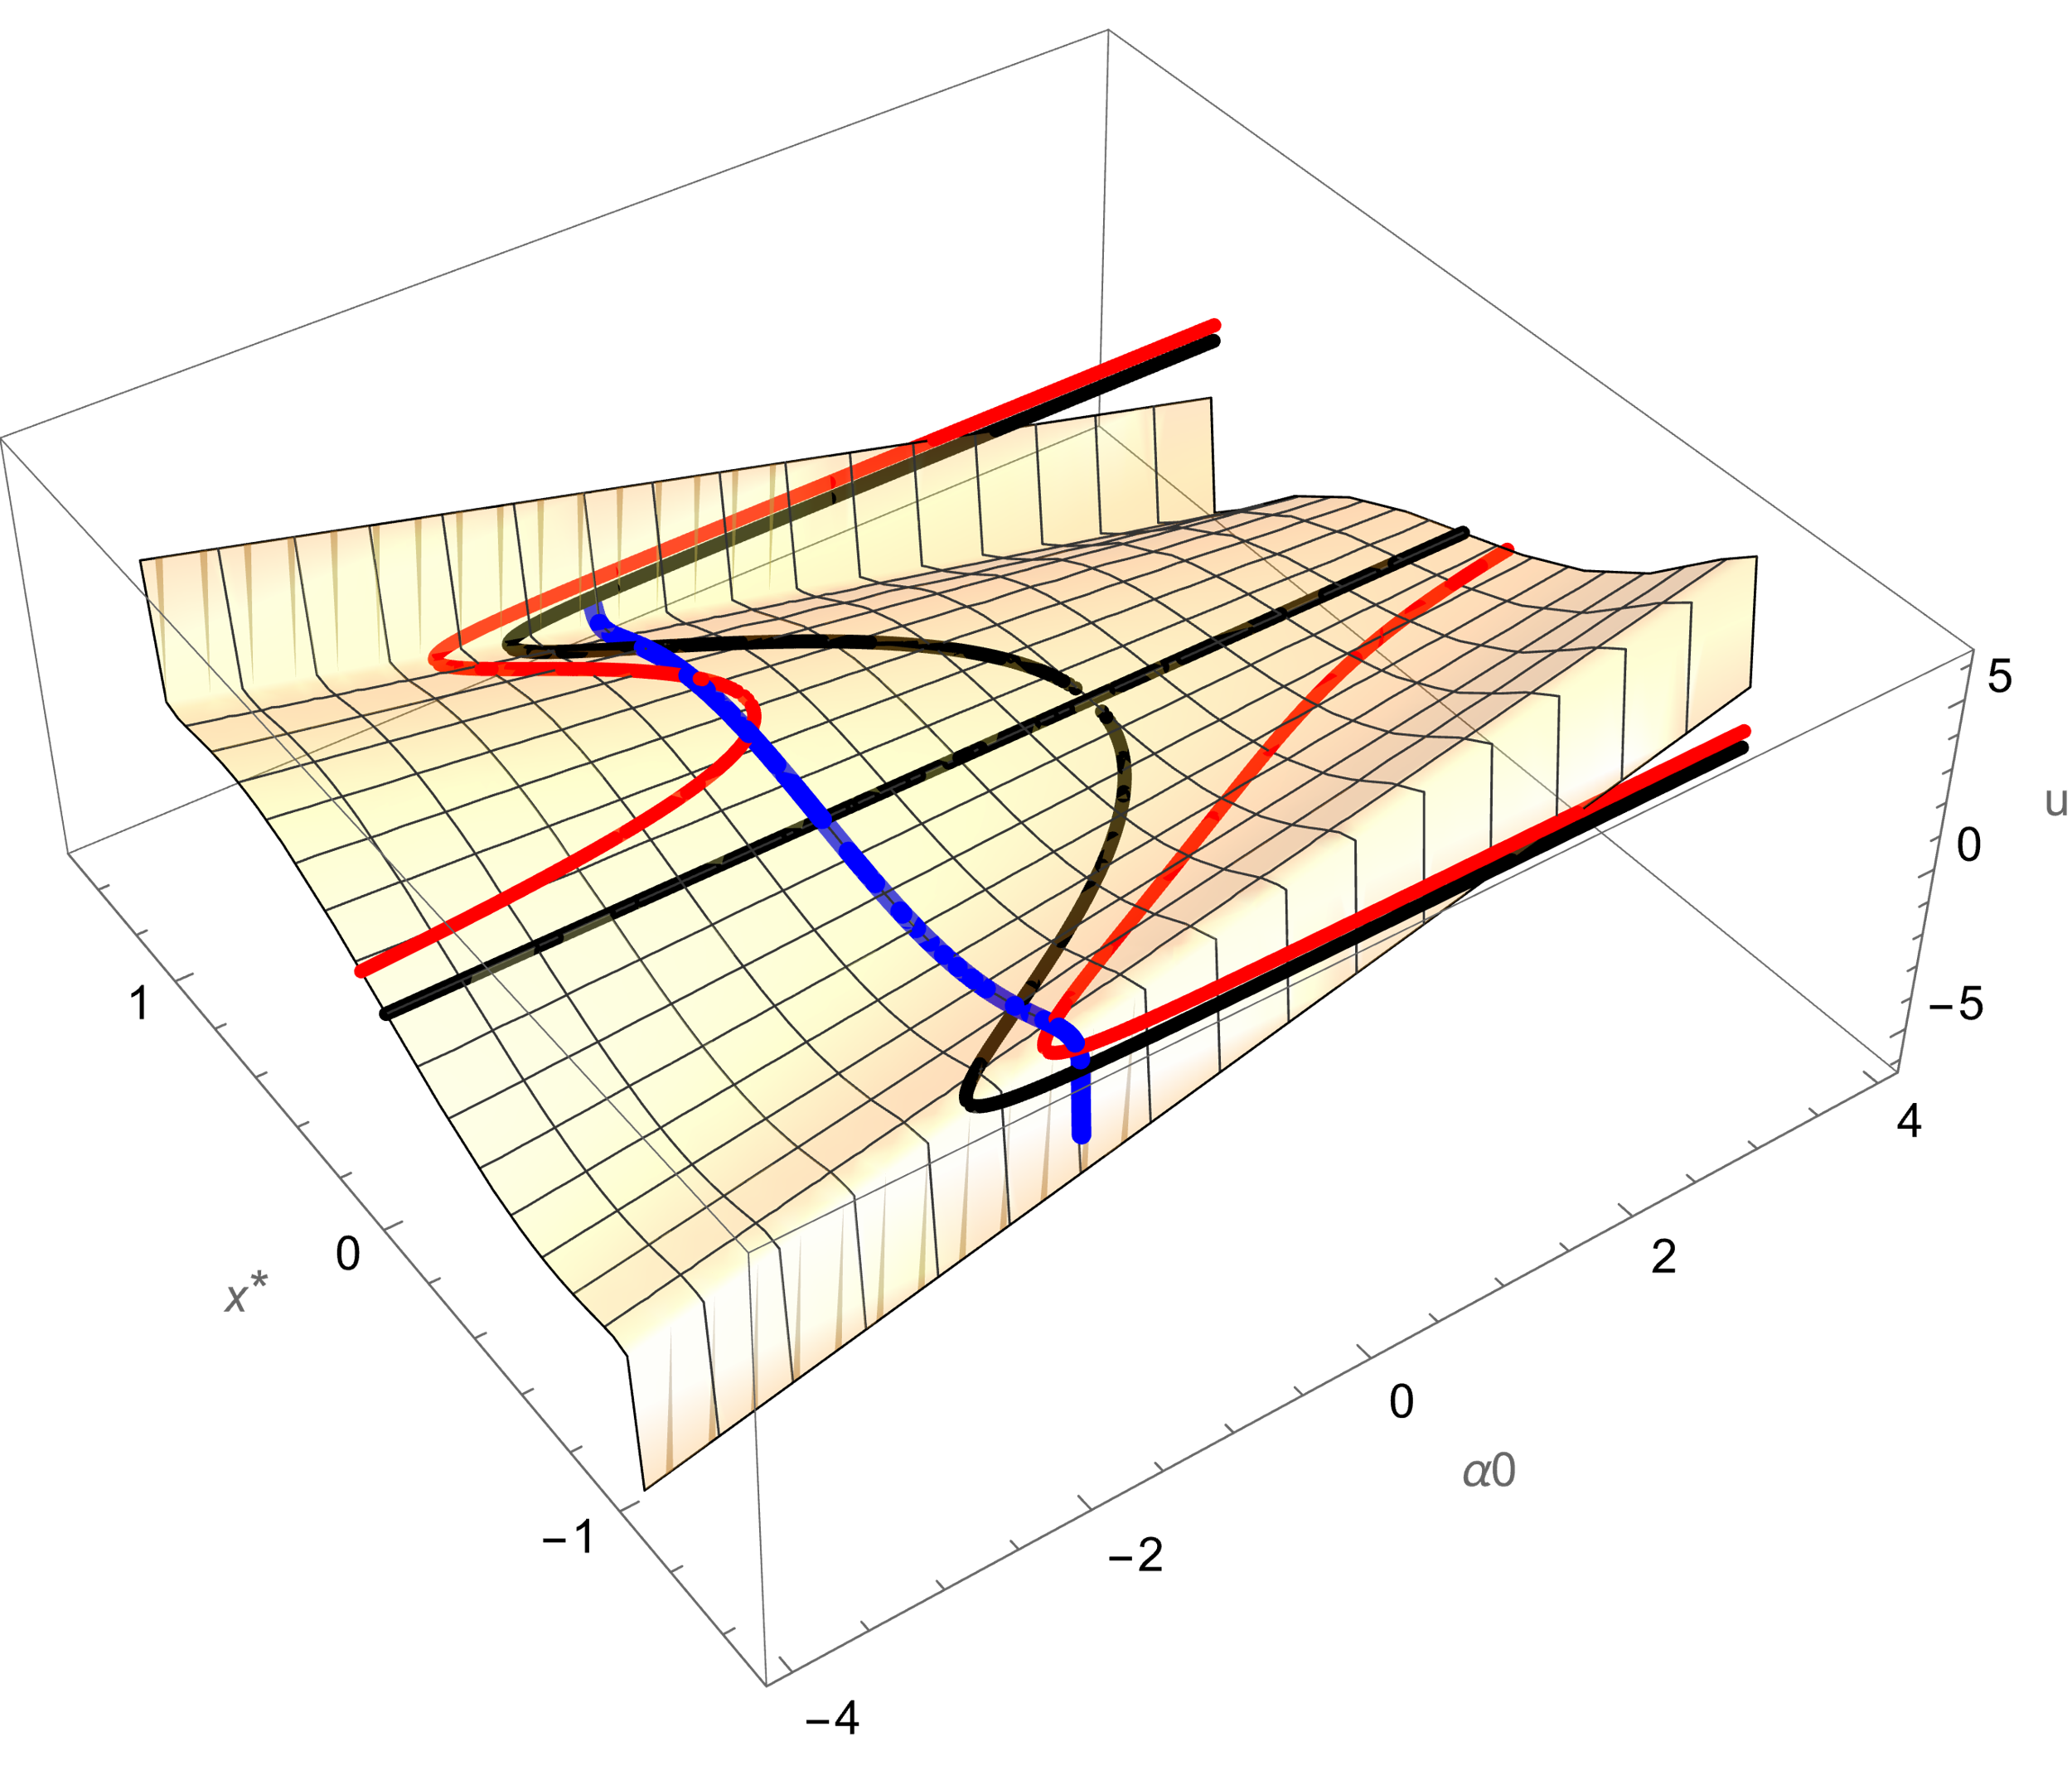
Separation of time-scales and state dependent attention
Designing nullclines for flexible decision-making
Subcriticality for decision-making, digital response
How will it unfold? (Draw)

Slide 23
Separation of time-scales
Two dimenisions, phase plane
Singular perturbation theory
With separation of timescales, phase plane is a bifurcation plot

Slide 24
Two individuals

Slide 25
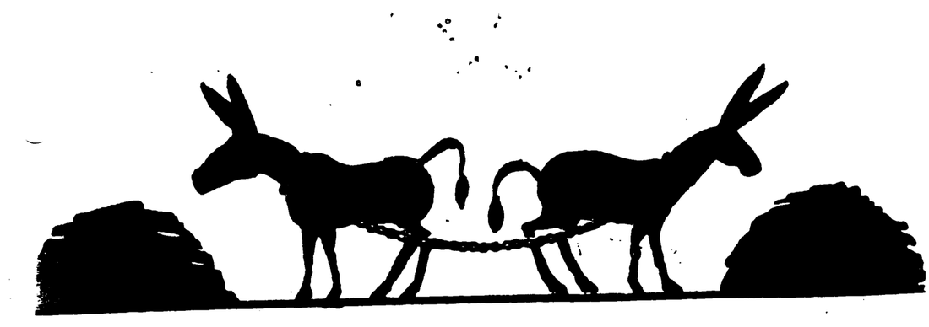
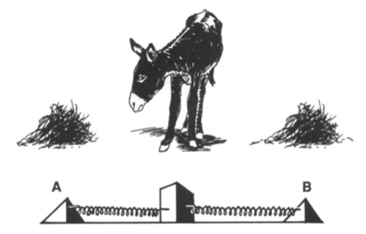
Symmetries in dynamical systems
Why do we care about symmetries in dynamical systems?
1) Model development
2) Model analysis
All decision-making systems should exhibit symmetry. This models decision-making in absence of evidence.
Problem of symmetry-breaking: problem of deadlock (individual) and consensus formation (collective)
A model with symmetry can be reduced and simplified.
Example: mapping between ring attractor (many dimensions) and drift-diffusion (one dimensional)
Buridan’s ass

Slide 26
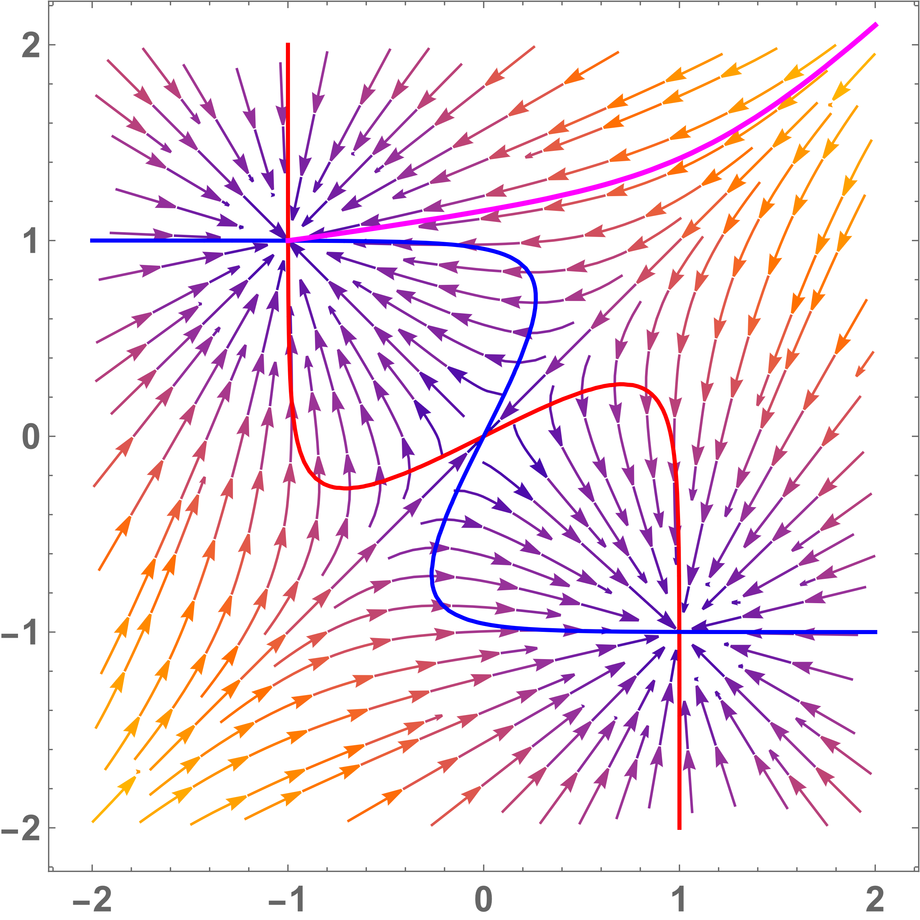
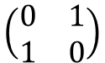
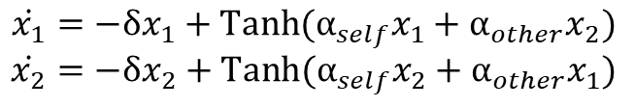
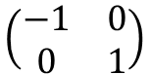
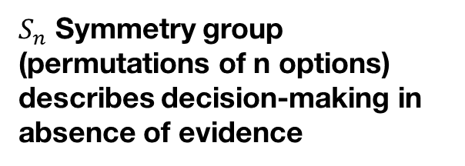
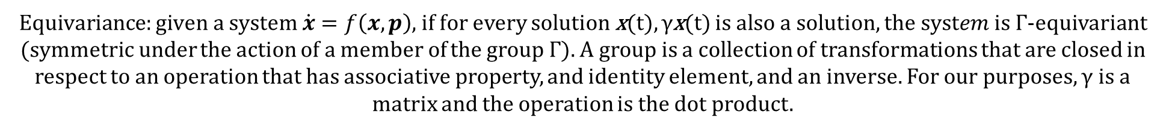
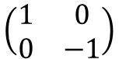
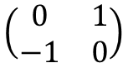
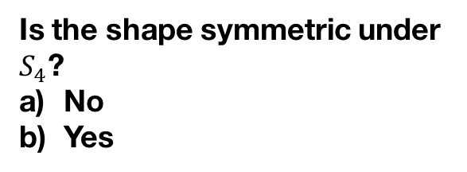



Symmetries in dynamical systems
$Equivariance:given a system \dot{x}=f\left(x,p\right)$, if for every solution x(t), γx(t) is also a solution, $the system$is Γ-equivariant (symmetric under the action of a member of the group Γ). A group is a collection of transformations that are closed in respect to an operation that has associative property, and identity element, and an inverse. For our purposes, γ is a matrix and the operation is the dot product.
Two ways to establish symmetry:
Verify the criteria $\text{γ}f\left(x,p\right)=f\left(\text{γ}x,p\right)$ Proof: $\dot{x}=f\left(x\right), y=\text{γ}x\text{, }\dot{y}=f\left(\text{γ}x\right),\text{γ}\dot{x}=\text{γ}f\left(x\right)→\text{γ}f\left(x\right)=f\left(\text{γ}x\right)$
2) Just look at the vector field
$S_{n}$ Symmetry group (permutations of n options) describes decision-making in absence of evidence
Under what transformation(s) is the system equivariant:
a)
$$\left(\begin{matrix}1 & 0 \\ 0 & −1\end{matrix}\right)$$
b)
$$\left(\begin{matrix}−1 & 0 \\ 0 & −1\end{matrix}\right)$$
Is the shape symmetric under $S_{4}$?
No
Yes
c)
$$\left(\begin{matrix}0 & 1 \\ 1 & 0\end{matrix}\right)$$
d)
$$\left(\begin{matrix}−1 & 0 \\ 0 & 1\end{matrix}\right)$$
$$α_{self}>0$$
$$α_{self}<0$$
1
2
1
3
e)
$$\left(\begin{matrix}0 & −1 \\ 1 & 0\end{matrix}\right)$$
f)
$$\left(\begin{matrix}0 & 1 \\ −1 & 0\end{matrix}\right)$$
$$\dot{x_{1}}=−δx_{1}+Tanh⁡({α_{self}x}_{1}+{α_{other}x}_{2})$$
$$\dot{x_{2}}=−δx_{2}+Tanh⁡({α_{self}x}_{2}+{α_{other}x}_{1})$$
4
3
4
2

Slide 27





Symmetries in dynamical systems
$Equivariance:given a system \dot{x}=f\left(x,p\right)$, if for every solution x(t), γx(t) is also a solution, $the system$is Γ-equivariant (symmetric under the action of a member of the group Γ). A group is a collection of transformations that are closed in respect to an operation that has associative property, and identity element, and an inverse. For our purposes, γ is a matrix.
Two ways to establish symmetry:
Verify the criteria $\text{γ}f\left(x,p\right)=f\left(\text{γ}x,p\right)$ Proof: $\dot{x}=f\left(x\right), y=\text{γ}x\text{, }\dot{y}=f\left(\text{γ}x\right),\text{γ}\dot{x}=\text{γ}f\left(x\right)→\text{γ}f\left(x\right)=f\left(\text{γ}x\right)$
2) Just look at the vector field
Under what transformation(s) is the system equivariant:
$S_{n}$ Symmetry group (permutations of n options) describes decision-making in absence of evidence
a)
$$\left(\begin{matrix}1 & 0 \\ 0 & −1\end{matrix}\right)$$
b)
$$\left(\begin{matrix}−1 & 0 \\ 0 & −1\end{matrix}\right)$$
Is the following shape symmetric under $S_{4}$?
No
Yes
c)
$$\left(\begin{matrix}0 & 1 \\ 1 & 0\end{matrix}\right)$$
d)
$$\left(\begin{matrix}−1 & 0 \\ 0 & 1\end{matrix}\right)$$
1
2
1
3
e)
$$\left(\begin{matrix}0 & −1 \\ 1 & 0\end{matrix}\right)$$
f)
$$\left(\begin{matrix}0 & 1 \\ −1 & 0\end{matrix}\right)$$
$$m_{self}>0$$
$$m_{other}<0$$
$$\dot{x_{1}}=−δx_{1}+Tanh⁡(α{{(m}_{self}x}_{1}+{m_{other}x}_{2}))$$
$$\dot{x_{2}}=−δx_{2}+Tanh⁡(α\left({m_{self}x}_{2}+{m_{other}x}_{1}\right))$$
4
3
4
2

Slide 28

Symmetries in dynamical systems
$Equivariance:given a system \dot{x}=f\left(x,p\right)$, if for every solution x(t), γx(t) is also a solution, $the system$is Γ-equivariant (symmetric under the action of a member of the group Γ). A group is a collection of transformations that are closed in respect to an operation that has associative property, and identity element, and an inverse. For our purposes, γ is a matrix.
Two ways to establish symmetry:
Verify the criteria $\text{γ}f\left(x,p\right)=f\left(\text{γ}x,p\right)$ Proof: $\dot{x}=f\left(x\right), y=\text{γ}x\text{, }\dot{y}=f\left(\text{γ}x\right),\text{γ}\dot{x}=\text{γ}f\left(x\right)→\text{γ}f\left(x\right)=f\left(\text{γ}x\right)$
2) Just look at the vector field
Under what transformation(s) is the system equivariant:
$S_{n}$ Symmetry group (permutations of n options) describes decision-making in absence of evidence
a)
$$\left(\begin{matrix}1 & 0 \\ 0 & −1\end{matrix}\right)$$
b)
$$\left(\begin{matrix}−1 & 0 \\ 0 & −1\end{matrix}\right)$$
c)
$$\left(\begin{matrix}0 & 1 \\ 1 & 0\end{matrix}\right)$$
d)
$$\left(\begin{matrix}−1 & 0 \\ 0 & 1\end{matrix}\right)$$
Symmetric systems can have non-symmetric solutions: this is symmetry breaking
$$α_{self}>0$$
$$α_{self}<0$$
e)
$$\left(\begin{matrix}0 & −1 \\ 1 & 0\end{matrix}\right)$$
f)
$$\left(\begin{matrix}0 & 1 \\ −1 & 0\end{matrix}\right)$$
$$\dot{x_{1}}=−δx_{1}+Tanh⁡({α_{self}x}_{1}+{α_{other}x}_{2})$$
$$\dot{x_{2}}=−δx_{2}+Tanh⁡({α_{self}x}_{2}+{α_{other}x}_{1})$$

Slide 29




Symmetries in dynamical systems
$Given a system \dot{x}=f\left(x,p\right)$, if for every solution x(t) γx(t) is also a solution, $f\left(x,p\right)$ is Γ-equivariant.
$$S_{n} symmetry group \left(permutations of n options\right) describes decisionmaking in absence of evidence.$$
$$Symmetric systems can have non−symmetric solutions:this is symmetry breaking.$$
Under what transformation(s) is the system equivariant:
$$\left(\begin{matrix}−1 & 0 \\ 0 & −1\end{matrix}\right)$$
$$\left(\begin{matrix}1 & 0 \\ 0 & −1\end{matrix}\right)$$
$$\left(\begin{matrix}0 & 1 \\ 1 & 0\end{matrix}\right)$$
$$\left(\begin{matrix}−1 & 0 \\ 0 & 1\end{matrix}\right)$$
Symmetric systems can have non-symmetric solutions: this is symmetry breaking
$$\left(\begin{matrix}0 & 1 \\ 1 & 0\end{matrix}\right)$$
$$\left(\begin{matrix}0 & 1 \\ −1 & 0\end{matrix}\right)$$

Slide 30
$$Ring attractor has C_{n} symmetry \left(cyclical shift of n options\right)$$
Definition of equivariance
Ask what symmetry does two-dimensional decision-making have
My cool plot for cir?
Symmetry breaking for equilibria despite symmetric system
Cn symmetry class (cyclic permutation group)

Slide 31
Linear stability analysis for multiple options
Jacobian
Leverage symmetry

Slide 32


Selective ultra-sensitivity
A ring attractor showing off his Fourier glasses
Mathematica notebook for designing input in frequency domain

Slide 33





Selective ultra-sensitivity
At the critical point, a decision-maker responds to inputs that have a non-zero component when projected along the center manifold (one of the dynamics’ dominant eigenvector)
Partially aligned input
Input $υ$
System dynamics
​${proj}_{v}υ$
Dominant
eigenvector v
Misaligned input
Input $υ$
System dynamics
Dominant
eigenvector v

Slide 34
Selective ultra-sensitivity
At the critical point, a decision-maker responds to inputs that have a non-zero component when projected along the center manifold (one of the dynamics’ dominant eigenvector)
This is linked to infinite susceptibility in finite size systems
For random inputs, dimensionality decreases probability of alignment
Partially aligned input
Input $υ$
System dynamics
​${proj}_{v}υ$
Dominant
eigenvector v
Misaligned input
Input $υ$
System dynamics
Dominant
eigenvector v

Slide 35
Selective ultra-sensitivity
At the critical point, a decision-maker responds to inputs that have a non-zero component when projected along the center manifold (one of the dynamics’ dominant eigenvector)
This is linked to infinite susceptibility in finite size systems
For random inputs, dimensionality decreases probability of alignment
For all symmetric unimodal kernels, the center manifold is spanned by the Fourier modes of the first harmonic. In addition, every linear combination of the Fourier modes of a given harmonic is also its corresponding eigenvector (which preserves symmetry of opinion formation)
Partially aligned input
Input $υ$
System dynamics
​${proj}_{v}υ$
Dominant
eigenvector v
Misaligned input
Input $υ$
System dynamics
Dominant
eigenvector v

Slide 36


Obtaining oscillations through bifurcations
Saddle node on invariant circle
Hopf bifurcation (supercritical)
$$\dot{x}=f\left(x, p\right)=ε_{1}p+{ε_{2}x}^{2}$$
Hopf bifurcation (subricitcal)
$$ε_{i}∈\{−1,+1\}$$

